Slide 1

Unit 13

Slide 2
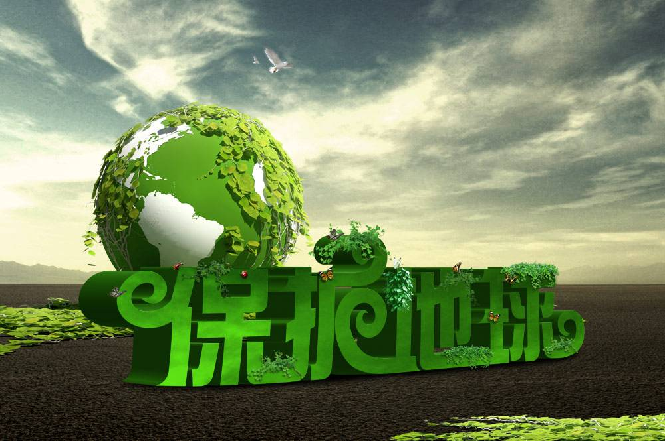
Unit 13
We're trying to save the earth!

Slide 3
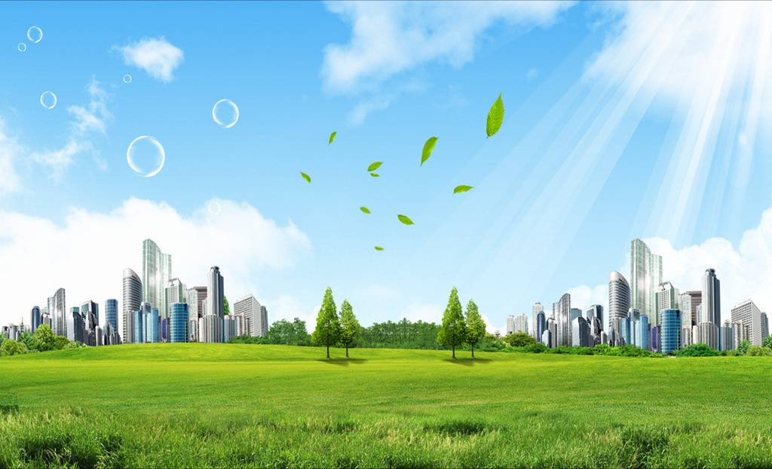


Slide 4


1. To talk about how to protect our earth.
2. To learn to use some words and expressions.
stop riding in cars
don’t use paper napkins
recycle books and paper
turn off the lights
3. To know the importance of protecting the environment and take actions to protect the environment.

Slide 5


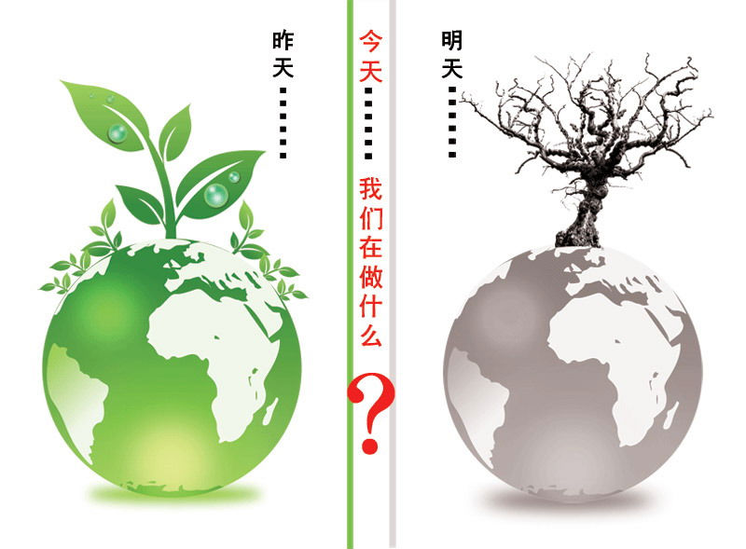
What should we do to save the earth?

Slide 6
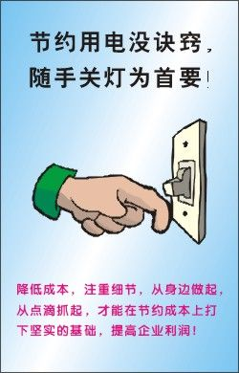
Turn off the lights when we leave a room.

Slide 7
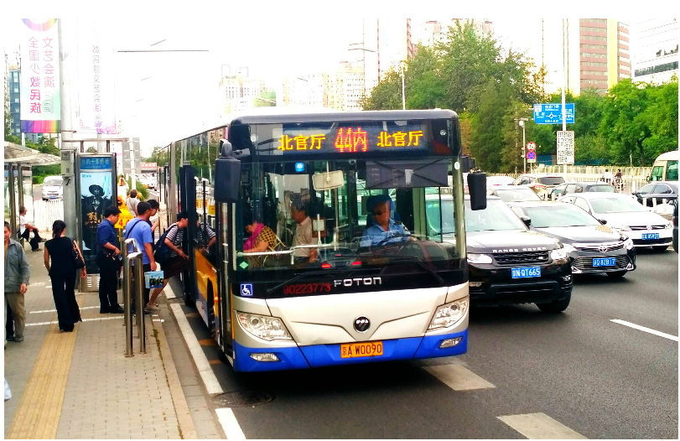
take the bus instead of driving

Slide 8
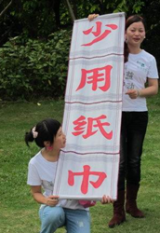
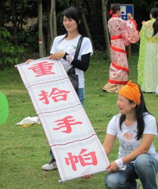
reduce using paper napkins
n. 餐巾, 餐巾纸

Slide 9
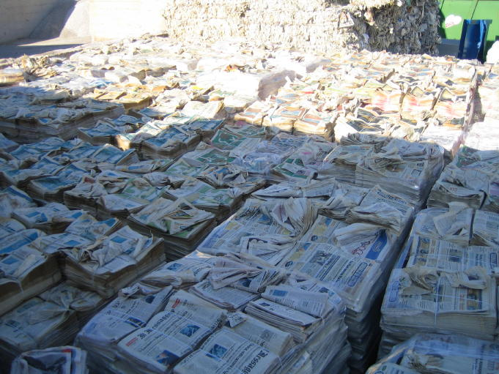
recycle books and paper
v. 回收利用; 再利用

Slide 10
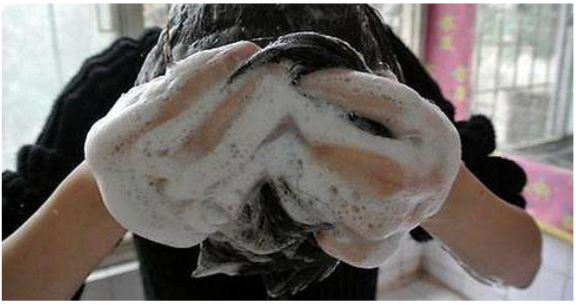
Turn off the shower while we are washing our hair.

Slide 11

1a
Rank these items from the easiest (1) to the most difficult (5).
___ stop riding in cars
___ recycle books and paper
___ turn off the lights when you leave a
room
___ turn off the shower while you are
washing your hair
___ don’t use paper napkins

Slide 12
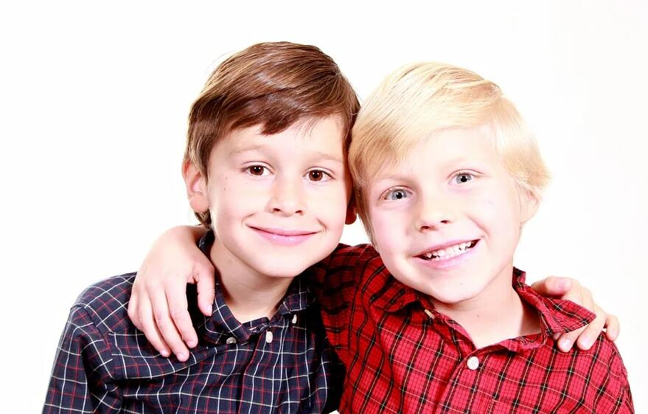
1b
Compare your answers in 1a with
your partner.
I agree. But it’s hard to stop riding in cars.
Recycling paper is really easy.

Slide 13



Listen for the general idea of the conversation.
The general idea of the conversation between Julia and Jack is about _______.
A. air pollution
B. water pollution
C. things to do to save the earth
C

Slide 14
1c
Listen and check (√ ) the things that Julia and Jack talk about.
Things Julia and Jack talk about | Things Julia is doing now | Things Julia will do in the future | Things Julia would never do
___turning off the lights
___turning off the shower
___not using paper napkins
___taking your own bags when shopping
___not riding in cars
___riding a bike
___recycling paper

Slide 15
1d
Listen again. Check the things that Julia is doing now, the things she will do in the future and the things she would never do.

Slide 16
Things Julia and Jack talk about | Things Julia is doing now | Things Julia will do in the future | Things Julia would never do
___turning off the lights
___turning off the shower
___not using paper napkins
___taking your own bags when shopping
___not riding in cars
___riding a bike
___recycling paper

Slide 17


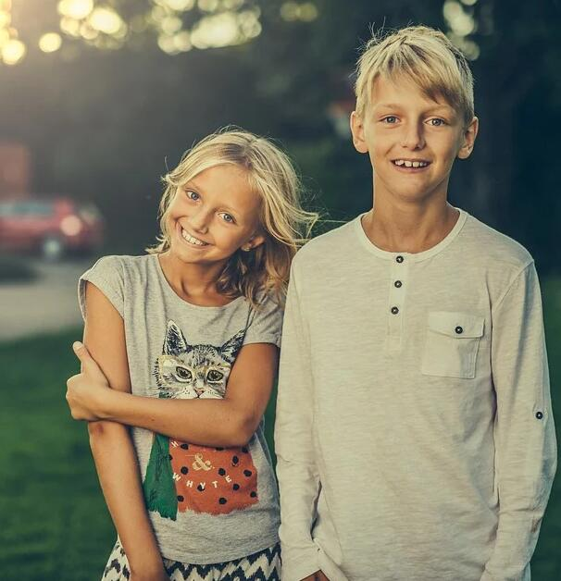
1e
Make a conversation using the information from the chart above. Say what is true for you.
We really shouldn’t use paper napkins, you know.
I know. I stopped using them last year.

Slide 18
Oh, I would never do that. I have very short hair, it only takes a few minutes to wash.
You should turn off the shower when you’re washing your hair.

Slide 19
Oh, that’s easy. I’ll do that from now on.
We should take our own bags when we go shopping.

Slide 20


turn off the lights / shower 关灯 / 淋浴
ride in cars 乘小汽车
paper napkins 餐巾纸

Slide 21

翻译下列句子。
1. 我使用毛巾而不是纸巾。
________________________________________
2. 当你购物时请带自己的袋子。
________________________________________
3. 循环使用书本和纸张是对环境有益的。
________________________________________
4. 我们去年就不用塑料袋了。
________________________________________
5. 为了环保你最好骑自行车或步行。
________________________________________
I use towels instead of paper napkins.
Please take your own bags when shopping.
Recycling books and paper is good for the environment.
We stopped using plastic bags last year.
You’d better ride a bike or walk for environment.

Slide 22


1. Write a short passage about more things you can do for our enviroment.
2. Preview the article Rethink, Reuse, Recycle.

Slide 23
